Slide 1
How Chatgpt works?
Digital - Data Science
25th May 2023

Slide 2
Recurrent Neural Network: Limitations
RNNs (or, LSTMS) as Language Models
Problems in RNNs – Long term dependencies | vanishing and exploding gradients, slow training, reasons
How to overcome the problems in RNNs?

Slide 3
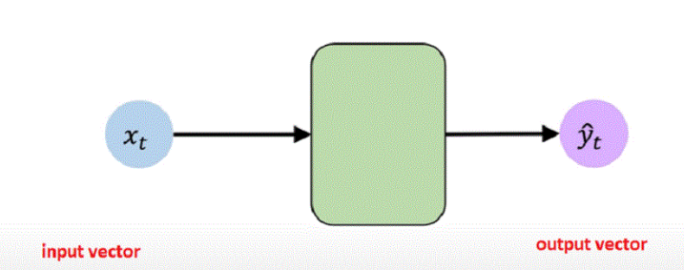
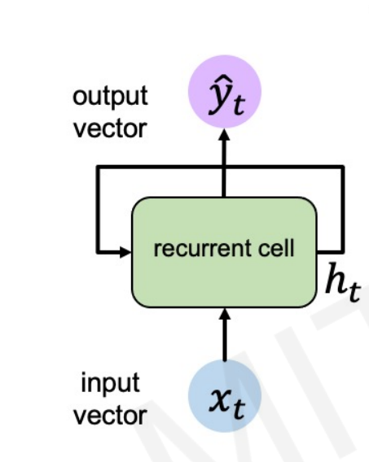
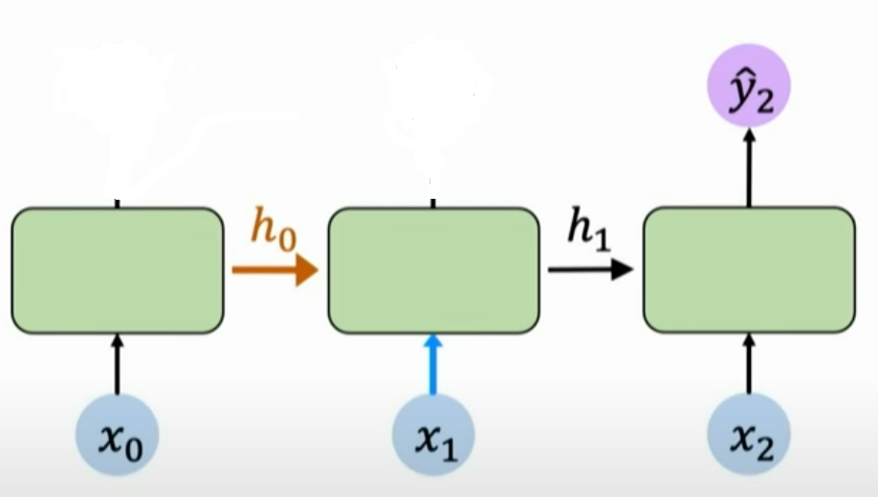
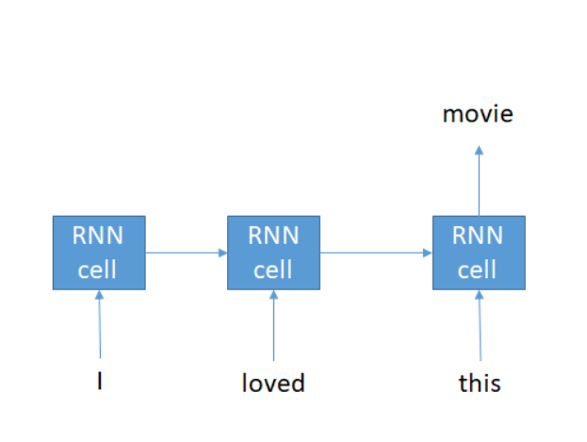
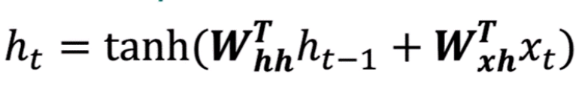
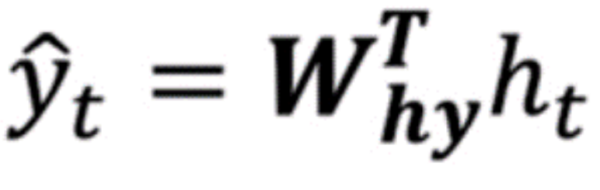
Recurrent Neural Networks as Language Models
Language – sequential processing of data
Recurrent neural network
Notion of “memory”
Semantic | Contextual meaning capture
Mathematical modelling
MEMORY!
Notes:
Building Neural Networks to solve Sequence Modelling problems
Firstly, let us start from the very fundamentals by revisiting the concept of the perceptron and develop a solid understanding of the changes that should be done to the neural network architecture in order to handle sequential data.
Starting from the concept of perceptron, we defined the set of inputs from x1 through xn and each of these numbers multiplied by a weight matrix and then they're going to all be added together to form this internal state of the perceptron which we'll say is z and then this value z is passed through a non-linear activation function to produce a predictive output y_hat as shown in the figure below.
It may be recalled that with the perceptron, one can have multiple inputs coming in and since we know we’re talking of sequence modelling, these inputs can be considered as being from a single time step in a sequence.
We could extend from the single perceptron to now a layer of perceptron’s to yield multi-dimensional outputs as shown in the figure below;
It should be underscored that the above mechanism does not have a notion of time or a sequence.
All the inputs and the outputs above can be thought of that coming from a fixed time step of a sequence.
Now – lets us simplify things. Let us simplify the diagram and collapse the hidden layer as shown:
Here, the input and the output vector are depicted of being of length m and length n respectively.
Now, if we apply the same model repeatedly for each time step in the sequence, we get a sense of how we could handle the individual inputs across different time steps as shown in the figure below;
All the models depicted above are replicas of each other at different time steps.
The output vector y_hat_t is going to be the function of the input at that time step as shown below;
Now taking a step back we know if we’re considering sequence data it is very likely that considering the sequence data the output of a label at a particular time step is going to depend on inputs at the prior time steps – so, we cannot treat the individual time steps as isolated steps.
Thus, we have to consider the relationship which is inherent to the sequence data considering the inputs between different time steps. So how to address this?
We need to link the information in the computation of the network at different time steps to each other.
Specifically, we are going to introduce internal memory or cell state denoted h_t;
The h_t is going to be the memory that will be maintained by the neurons and the network itself and this state can be passed from time step to time step across time.
The key idea here is that by having the recurrence relation we’re capturing the notion of memory. So, what this means now is that the network output predictions and the computations are not only the function of the input at a time step but also the memory of the cell state denoted by h_t.
Thus, the output depends both on the current input as well as the past computations and the past learning that occurs. One can define this relationship by means of functions that map the input to the outputs as below;
As we can see that we can describe the neurons via a recurrence relation which means the cell state depends upon the current input and again on prior cell states.
It is exactly this idea (see figure below) of recurrence relation that provides the intuition of the key operation behind the recurrent neural networks or RNNs and through the sections 3 and 4 below we build upon the understanding of the mathematics of the recurrence relation and the operations that define the RNN behaviour.

Slide 4
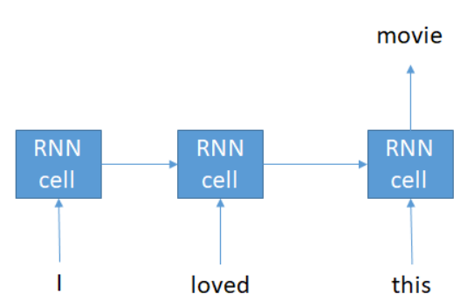
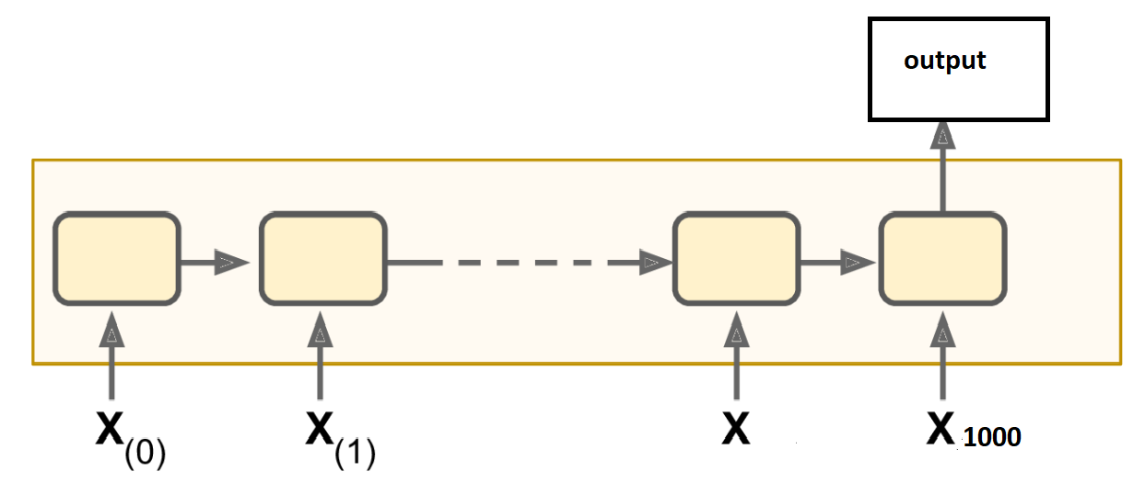
Problems in Recurrent Neural Networks (RNNs)
Sequential processing of data
Slow to train
Cannot make use of computational power (parallel processing, GPUs)
Notes:
Further, RNNs are slow to train, the inputs data needs to be passed sequentially or serially one after the other.
We need input data from the previous state to process any output from the current state.
RNNs were difficult to parallelize
Cannot make effective use of modern GPUs and computational power

Slide 5
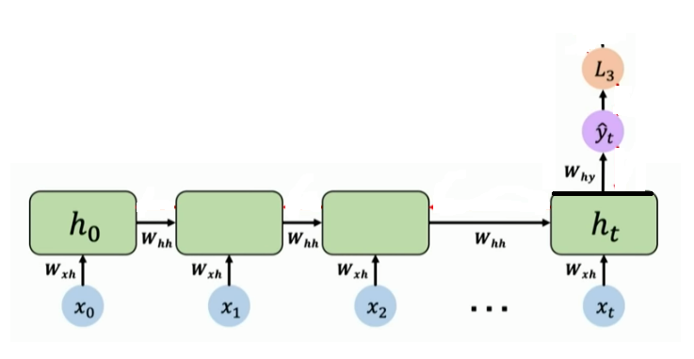
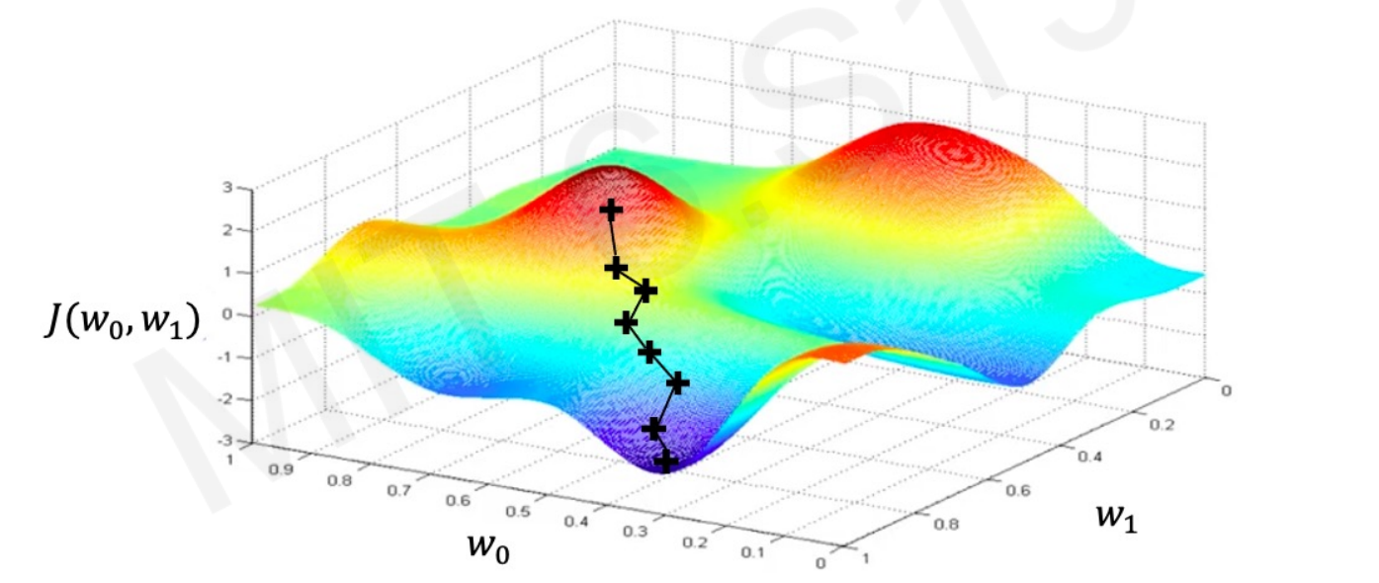
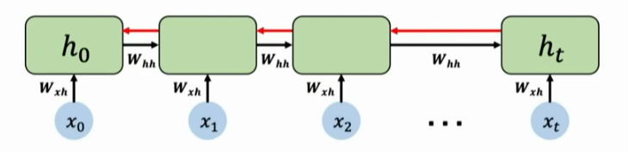
Problems in Recurrent Neural Networks (RNNs) - Continued
Training RNNs
Backpropagation with time
Computing the gradient with respect to h0 will involve many factors of W_{hh} and repeated gradient computation
Gradients > 1
Many values
Gradients < 1
Many Values
exploding gradients
vanishing gradients
Notes:
Further, RNNs are slow to train, the inputs data needs to be passed sequentially or serially one after the other.
We need input data from the previous state to process any output from the current state.
RNNs were difficult to parallelize
Cannot make effective use of modern GPUs and computational power

Slide 6
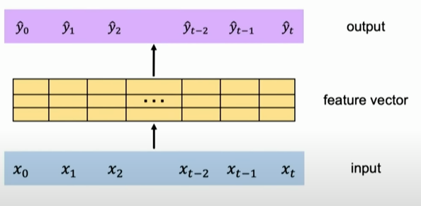
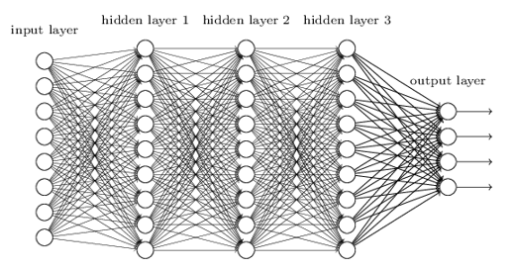
How to overcome the problems in RNNs?
How to get rid of sequential processing?
How to parallelize the computation?
Can we use feed forward networks – following concatenation?
Eliminates recurrence - but
No Scalability
No order
No notion of memory
What do we want to achieve?
Notes:
How do we overcome the limitations of RNNs?
As pointed in the preceding paragraphs, RNNs use time step by time step processing of data – the notion of recurrence – to maintain the order information. We discussed the key limitations and reiterated those limitations in the section above.
Thus, what we want now is, that, rather than sequential time step by time step processing of data, we would like to process the information continuously as a continuous stream of information. Rather than being slow, we’d like to parallelize the computation to speed up the processing and importantly establish long memory that can build rich understanding of context, understanding of sequential data.
Can we use feed forward networks?
Thinking of resolving the problems of RNNs, a naïve approach will be to squash all the data/ all the time steps together to create a vector that effectively concatenated the time steps together, feed all the data to a feed forward network which through its densely connected layers does the learning and gives you the outputs.

Slide 7
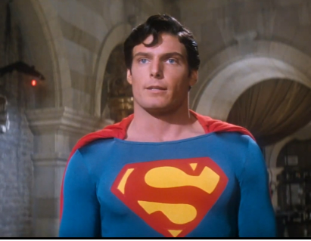
What do we want to achieve?
Image:
How humans detect images?
Pay “attention” to specific parts of the image
“Attend” to what is important in sequential data
Concept of “Attention”
How do we scan text?
Text:
To every action there is an equal an opposite reaction
Hence this is Newton’s third law – “attention”
Notes:
We need to extract the information from the input data more intelligently – the key idea being to identify and “attend” to what is important in a sequential data, and
This is the notion of attention mechanism which is an extremely powerful concept in modern deep learning and natural language processing.

Slide 8
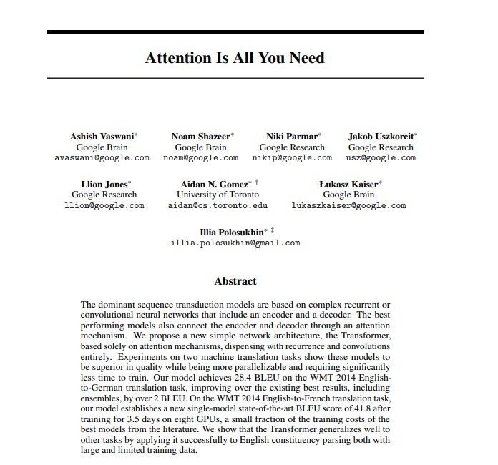
“Attention Is All You Need”
Intuition of Attention: Query, Key, Value
Attention in Transformers
An overview of the Transformer Architecture and
understand the ‘heart’ of the architecture : Attention
Attention Is All You Need
Notes:
Transformer Neural Network Architecture
In 2017, the Transformer Neural Network architecture was introduced.
The network employs an encoder-decoder architecture much like the recurrent neural network. The following are some of the starting differences between the RNNs and the Transformer architecture;
In an RNN encoder, we pass the input sentence one word after the other. The current word’s hidden state has dependencies on the previous word’s hidden state, the word embeddings are generated one word at a time.
Whereas, with a transformer encoder, there is no concept of “time step” – we pass in all the words of the sentence simultaneously and determine the “word embedding” simultaneously as shown in the figure below;

Slide 9
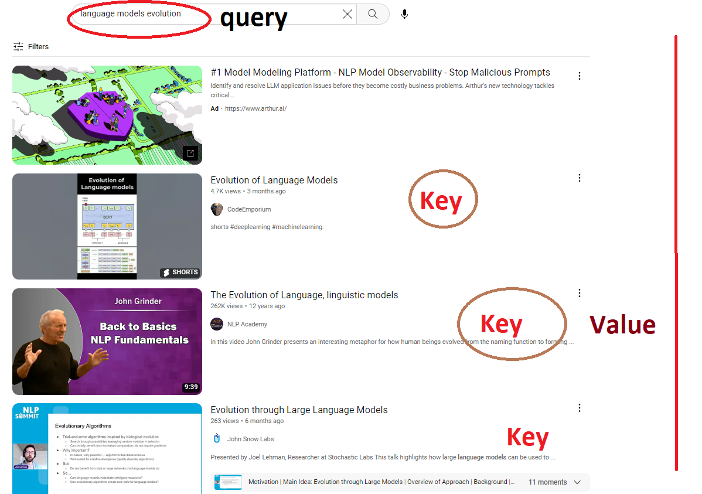
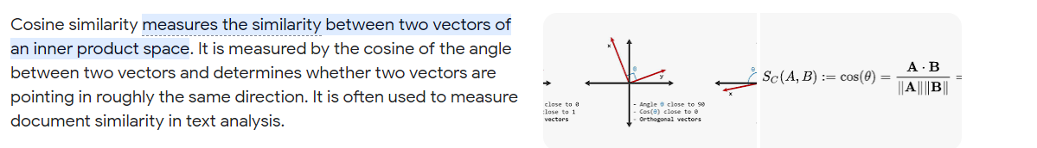
Intuition of Attention: Search
E.g. You Tube video search (Query)
Key-1, Key-2, Key-3
You spot the relevant videos (similarity with the title)
Similarity metric – similarity between the query and the keys
Cosine Similarity (Dot Product)
best matched video
(You find out which video to “attend” to)
Notes:
The intuition of attention can be best felt through search.
For example, in order to search about “the evolution of language models” through the database of You-Tube videos, you will type in a query “evolution of language models”.
In every video, that appears, you will have some key information related to the title.
We need to find the overlap between the query and each of these titles – the “keys” in the database.
We need to compute a similarity / relevance metric to find the relevance between query and each key that appears.
Mathematically, the similarity metric we compute is a dot product or cosine similarity.
We extract the relevant information wat we want to pay attention to. We get a Value. We extract the relevant video.

Slide 10
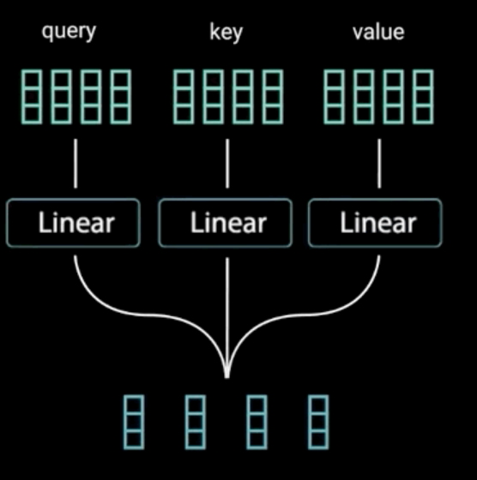

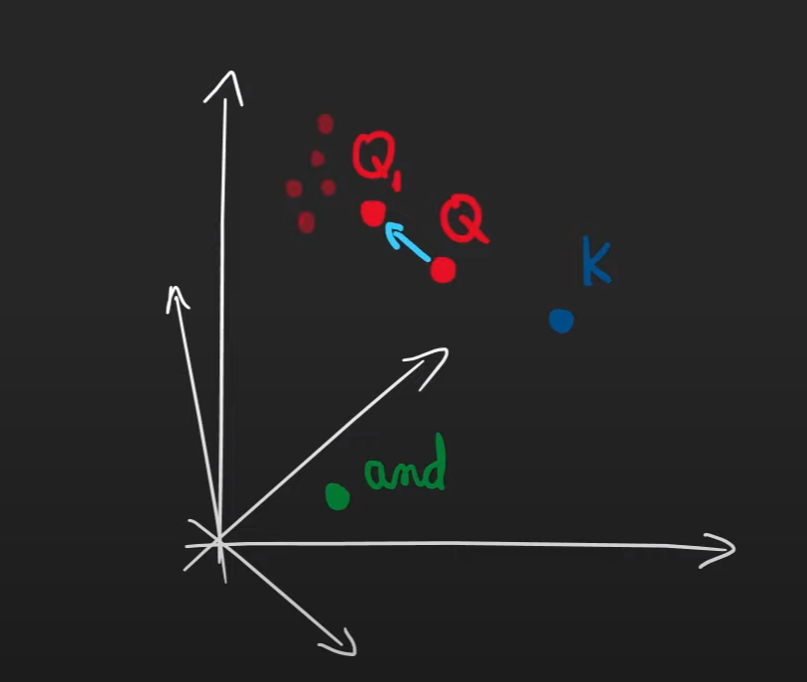
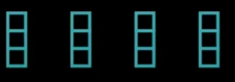
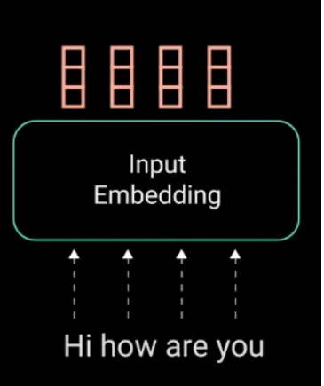
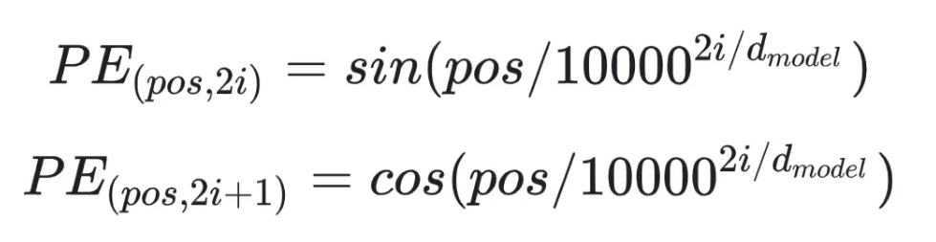
Attention in Text - embeddings
Each positional embedding passes through a Linear Neural Network layer – extract Query, Key, Value
(no activation)
Positional Input Embedding
Input Embeddings
why sines and cosines?
Notes:
Let’s go back to our text/language example, with this sentence the goal is to identify features in the input that are relevant to the semantic meaning of the sentence. [This is important because when we’re dealing language and making a language model to predict the next word I ought to know the semantic meaning of the sentence]
We perform the following operations:
Encode the positional information.
Extract query, key and value – exactly similar to search operation
Compute attention weights
Extract features with high attention
Positional embedding are the identifiers that are added to the original word embedding for the Transformers to know the order of the sequence.
The positional embedding should fulfil certain requirements:
Every position must have the same identifier irrespective of the sequence length.
It should be noted that the positional embeddings push the original input embedding, care should be taken to see that the input embedding do not get drifted away too far away so that the semantic meaning of the embedding is lost.
We could think of numbering the positional embedding as 1, 2, 3 but that violates the above rule!
We thus need to keep the value of the positional embedding bounded.
To keep the values of the input embedding bounded, we choose functions of sine and cosine, sines and cosines are bounded between -1 and +1 range from – infinity to + infinity
We take both sines and cosines because: had we taken only sines we might have got some repeated position values which is not permitted by 1)
Hence, we take both sines and cosines.

Slide 11
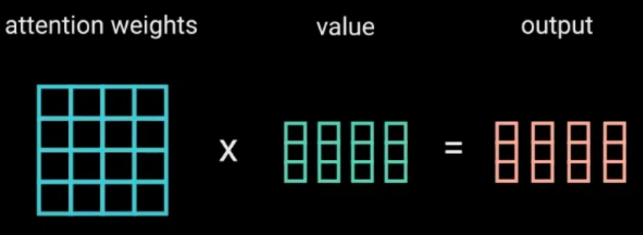
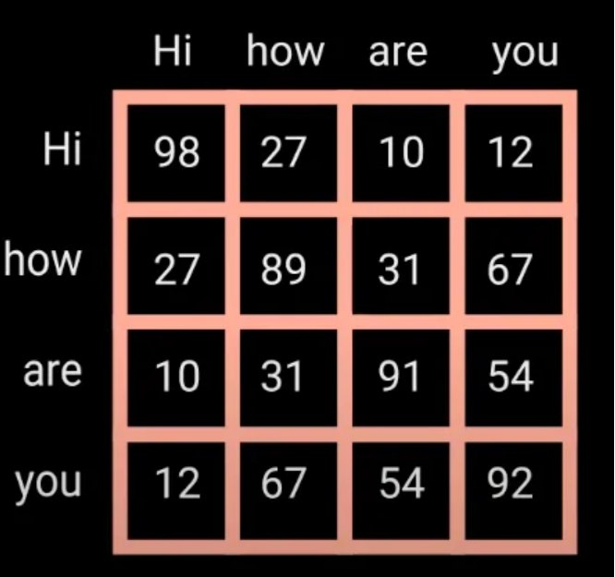
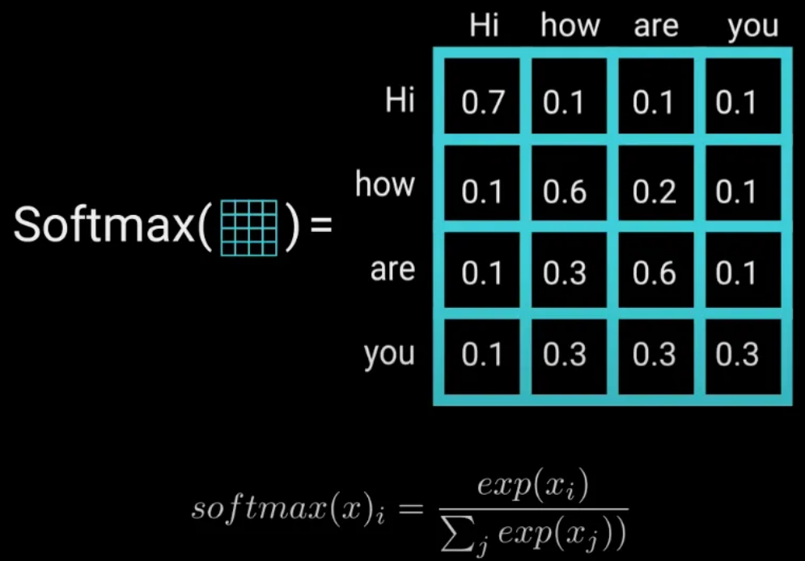
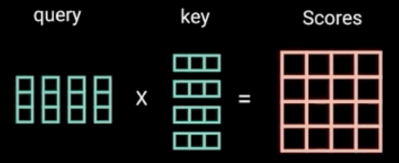
Attention in Text – word embeddings
(understand how to read the scores)
The output of the Attention Layers is passed to a Feed Forward layer for further processing and then to a Linear Layer that acts as a classifier (Depending upon the classes of words) and then to softmax
The intuition here is to keep intact the values of the word(s) we want to focus on, and throw-out irrelevant words – these word vectors are context aware

Slide 12
Key take-aways of the process described:
Attention weighting
All these operations encode the input to represent “attention” information
For a language model, the attention weights help us understand what parts of text to focus on to predict the next word.
For a language translation task, it will help the decoder to focus on specific part of the text during decoding process
Eliminate need for sequential processing and semantic capture without the time stepping

Slide 13
ChatGPT Training
Overview of ChatGPT Training Steps
The Rewards Model
Reinforcement Learning and ChatGPT

Slide 14
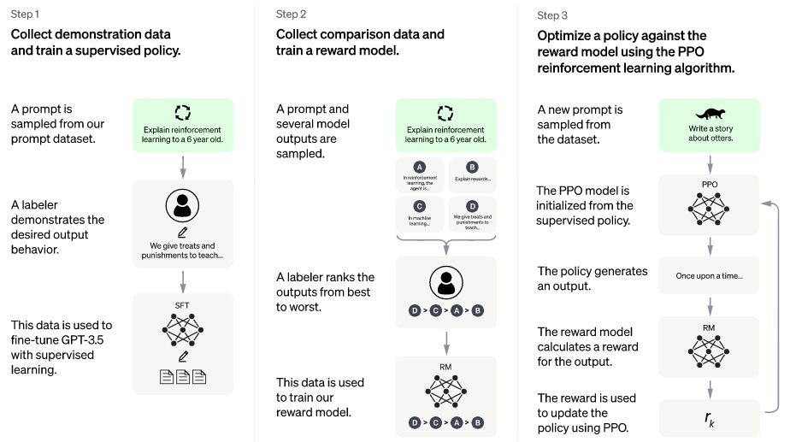
Overview of ChatGPT Training Steps
Step 1:
Pre-trained Model
Supervised Fine-Tuned Transformer (SFT) Model
Step 2
Rewards Model
Step 3
Proximal Policy Optimisation

Slide 15
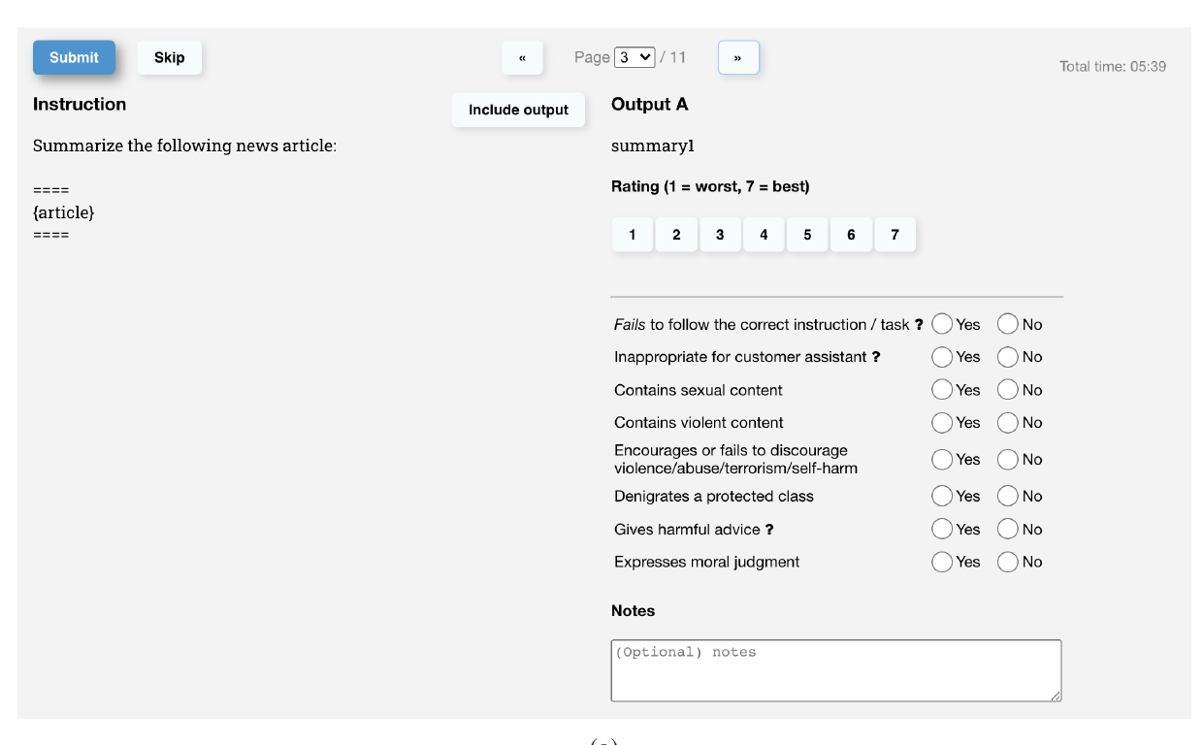
How ChatGPT Works: The Model Behind the ChatBot
Data Science Lunch Time Session: 30/03/2023
12 Demystifying Step 2 of ChatGPT Training: Labellers assessing the quality of the responses
Labellers assessing the quality of the responses
Likert Scale
1 – 7
Notes:
How do labellers assess the quality of the responses to train the Rewards model?
Thus, from the above it is clear that how ChatGPT may take the same prompt and yet generate different responses, and this is due to the probabilistic nature of the model meant to emulate human-like behaviour.
In the next part of Step 2, the labellers will have to rank multiple responses. By ranking, the labellers will have to assign a rewards value to the response because this rewards value is going to be used in the step-3 to further fine tune the supervised fine-tuned model of this step (step-2).
The question now needs to be addressed is that – in order for the labellers to rank the responses – how do you quantify the quality of the response?
The labellers assess the quality of the response based on the questionnaire as shown below:
The above screenshots are taken from the paper: “Training Language Models to follow instructions with human feedback” by OpenAI and can be found in the below Github Link: https://github.com/atanejajlr/language_models
This is important because we’d like ChatGPT To have an understanding of sensitive topics like: violent content, biased content, or sexually explicit content. All the human labellers will be asked to respond to the questionnaire and the response will then be aggregated.
The responses are filled up and only the responses corresponding to the majority are considered. The ratings are used to train the “Rewards Model”
Rewards Model is similar to the supervised fine-tuned model but with a scalar output. I have not gone into more details of the Rewards model, but the details are available in the attached paper on InstructGPT.
This Rewards model (after training) is then used to assess the quality of the response and further fine tune the fine-tuned model of step 1 in order to generate more human like responses which are factual and not toxic.

Slide 16
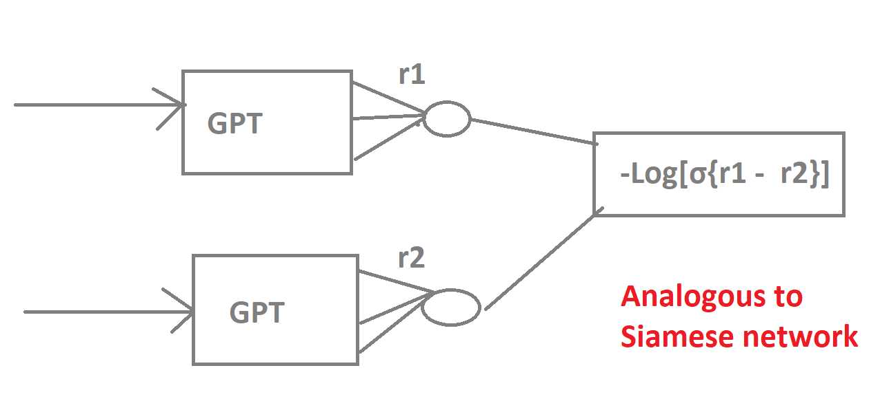
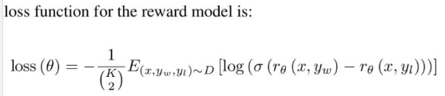
How ChatGPT Works: The Model Behind the ChatBot
Data Science Lunch Time Session: 30/03/2023
generated rewards
13 Demystifying Step 2 of ChatGPT Training: How do we train the Rewards model?
loss function
Rewards model is same e as SFT but with scalar output
Input is: prompt + response
Analogous to Siamese network
Exact loss function
x is the prompt vector and
yw and yL the pair of responses (just like a pair of image vectors in a Siamese network as mentioned above) ,
theta are the parameters you are learning,
K 2 is the notation for nC(n-2) combinations
compare these to the actual labels that were generated – which response was better?
exact loss function
Notes:
The Rewards model is, essentially same as the Supervised Fine Tuned model of step 1 if you imagine that the output of step 1 being combined together to form a scalar output.
We pass in all combinations nC(n-2) of different ChatGPT responses together to carry out the comparison of the ratings obtained by different labellers.
This is analogous to the Siamese network on face recognition systems where you carry out the comparison of combination of differences of image vectors often employed in face recognition systems of people passing through turnstile in an office.
Back propagation us carried out and gradients updated to minimize the loss function
In the equation below x is the prompt vector and yw and yL the pair of responses (just like a pair of image vectors in a Siamese network as mentioned above) , theta are the parameters you are learning, K 2 is the notation for nC(n-2) combinations

Slide 17
Reinforcement Learning and ChatGPT
Fine tuning of the Supervised Fine Tuned Model
Using the Rewards model

Slide 18
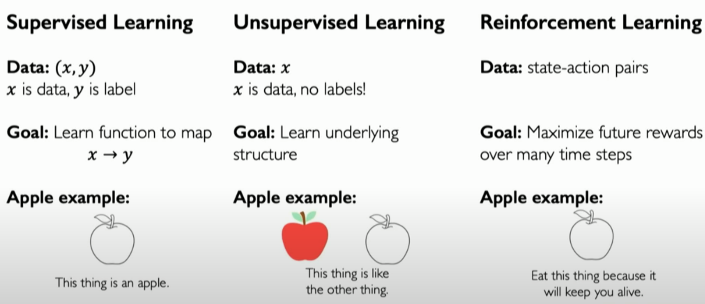
Reinforcement Learning - Definition
What is Reinforcement Learning?
Supervised Learning vs Unsupervised Learning vs Reinforcement Learning
ChatGPT and Reinforcement Learning

Slide 19
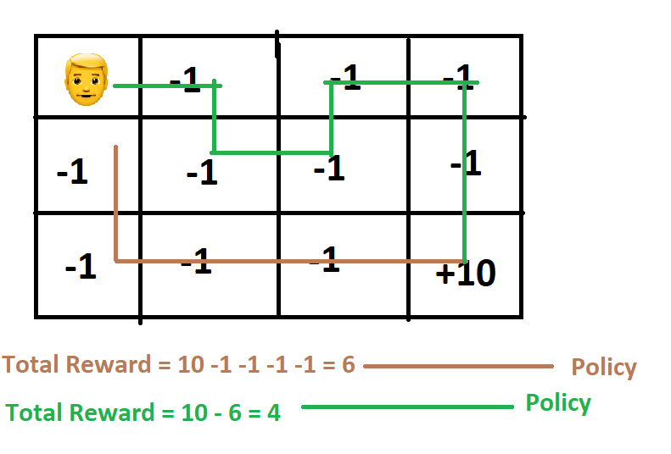
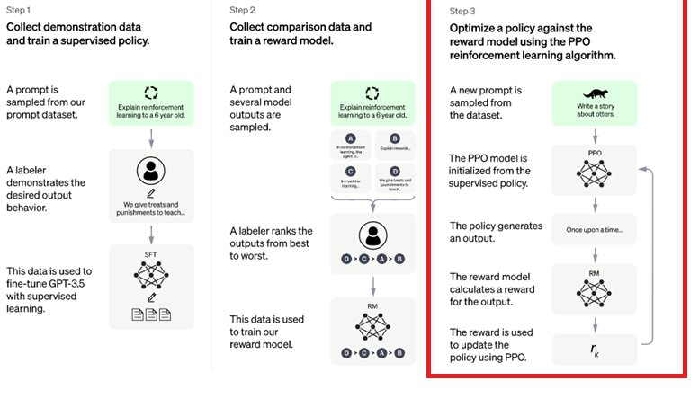
Terminologies | Reinforcement Learning and ChatGPT
Agent
State
Action
Policy

Slide 20
Fine Tuning the Supervised Fine Tuned Model
Notes:
Transformer Neural Network Architecture
In 2017, the Transformer Neural Network architecture was introduced.
The network employs an encoder-decoder architecture much like the recurrent neural network. The following are some of the starting differences between the RNNs and the Transformer architecture;
In an RNN encoder, we pass the input sentence one word after the other. The current word’s hidden state has dependencies on the previous word’s hidden state, the word embeddings are generated one word at a time.
Whereas, with a transformer encoder, there is no concept of “time step” – we pass in all the words of the sentence simultaneously and determine the “word embedding” simultaneously as shown in the figure below;

Slide 21
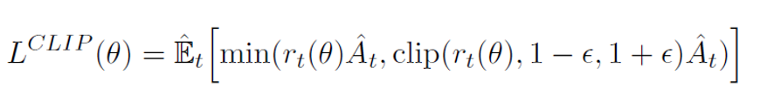
How ChatGPT Works: The Model Behind the ChatBot
Data Science Lunch Time Session: 30/03/2023
Ensures that change in parameters is not too large
15 Mathematics of the loss function of the Proximal Policy Optimisation (PPO)
parameters that are fine tuned
advantage function
rewards ratio – new parameters/old parameters
In the Proximal Policy Optimisation, the Reward is used in the loss function itself.
the Rewarded generated has to be utilized to further fine tune the Supervised Fine-tuned model. The above us the loss function used to make the gradient updates. In the above equation:
Notes:
Mathematics of the loss function of the loss function of the Proximal Policy Optimisation (PPO):
As mentioned, in the Proximal Policy Optimisation, the Reward is used in the loss function itself.
Let is examine the mathematics of the Loss function in a bit detail.
The equation below is taken from the paper: Proximal Policy Optimization Algorithms
Reiterating, the Rewarded generated has to be utilized to further fine tune the Supervised Fine-tuned model. The above us the loss function used to make the gradient updates. In the above equation:
ϴ is the parameter in the Supervised Fine-Tuned model which we will be updating
t is the time step
Every single time step we have one complete response that is one-time step.
r is the Rewards ratio – it is the ratio of the rewards with the new parameters for the given input divided by the reward of the old parameters with the same given input
Therefore, if the rewards ratio is higher than 1 it means the training is going in the right direction.
“A” is the Advantage Function – in Reinforcement learning, the advantage function assesses how high quality the output was with respect to the input. Thus, it is a number that is proportional to the reward
Thus, the product r.A is going to be very high if the response is very good.
clip – we do not want to make the gradient update too fast – we will clip the upper and the lower bound of the ratio by ϵ - how large the ϵ is will determine how much we are allowing the gradient update to change.
We then have an expectation – and this goes to the fact that we can generate for the same input prompt multiple kind of responses. So, we want to emulate this – we take the average of the values and so the entire proximal policy optimisation is not reliant on one output from ChatGPT. We make the gradient updates through “Gradient Ascend” as we’re maximizing the value.

Slide 22
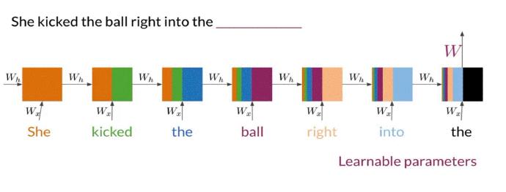
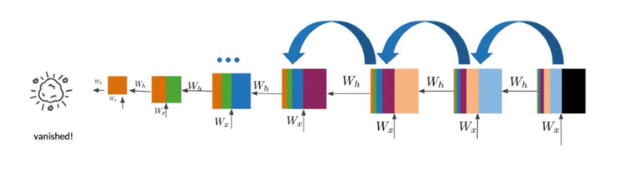
Problems in Recurrent Neural Networks
Sequential processing of data
Slow to train
Cannot make use of computational power (parallel processing, GPUs)
Long Sequence Problems
Vanishing and exploding gradient problem in RNN
Two major problems to tackle!
Notes:
Recall: Back propagation in feed forward models
Starting with the first word of the sequence, the hidden value at the far left, the first values are computed here.
Then it propagates some of the computed information, takes the second word in the sequence, and gets new values.
One can see that process illustrated here, the orange area denotes the first computed values, and the green denotes the second word
The second (hidden) values are computed using the older values in orange, and the new word in green.
After that, it takes the third word and propagates the values from the first and second words and computes another set of values from both of those, and it continues in a similar way from there.
At the final step, the computations contain information from all the words in the sequence, and the RNN can predict the next word, which in this example is goal.
Note that in an RNN, the information from the first step doesn't have much influence on the outputs. Therefore, you can see the orange portion from the first step decreasing with each new step.
Correspondingly, computations made at the first step don't have much influence on the cost function either.

Slide 23
Tra

Slide 25
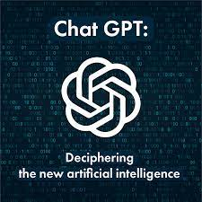
Recurrent Network Units
ChatGPT is a Large Language Model (LLM), in practise this works like the world's best auto-complete!
Large Language Models are based on Neural Networks trained on a LOT of data.
The model predicts what the next most probably word in a sentence is going to be given the previous context.
This gives some really cool and powerful results as I'm sure a lot of you have seen!
But what better way to show what ChatGPT than a Live Demo!

Slide 26

Quick Demo

Slide 27
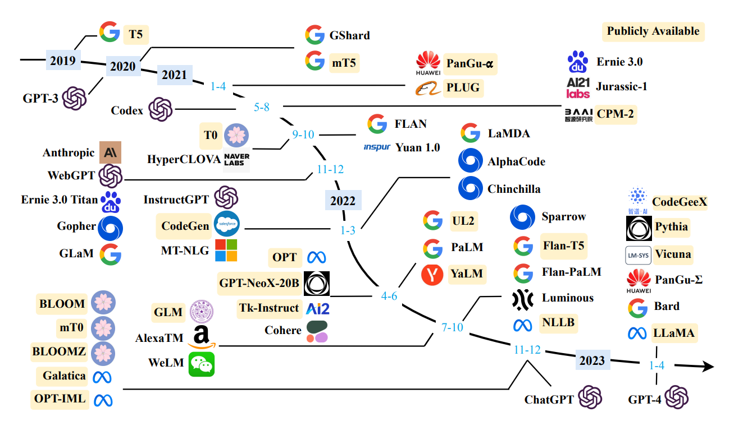
ChatGPT – History, LLM's have been around far before ChatGPT and there are a lot of different versions
OpenAI GPT Roadmap
GPT (0.1B)
GPT-2 (1.5B)
GPT-3 (175B)
Milestone of Generative AI
InstructGPT
instruction-formatted GPT
tuned with human feedbacks
ChatGPT
sibling model of InstructGPT
open access to everyone
New era of Language Models
Task model to general AI model
Data engineering to prompt engineering
A Survey of Large Language Models
(submitted on 31 Mar 2023 arXiv:2303.18223)

Slide 28
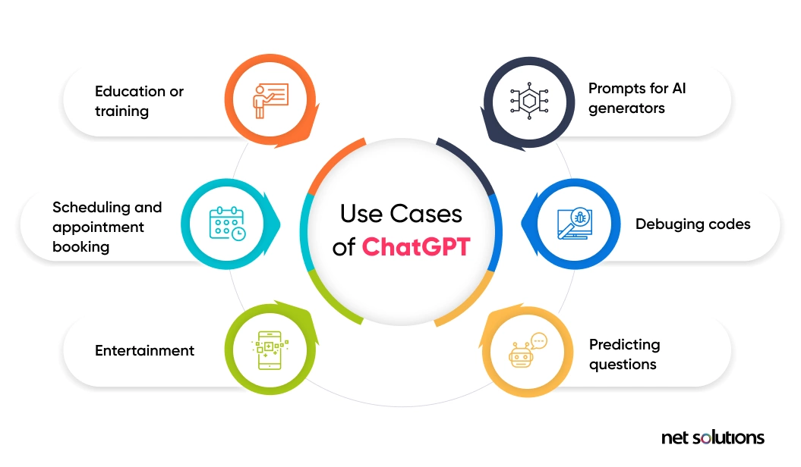
ChatGPT – Use Cases (There are so many applications in many different areas!)
Textual Applications
Content creation
Translation
Conversational AI
Sentiment analysis
Text Summarisation
Coding Applications
Writing code
Debugging
Code completion
Code refactoring
Code documentation
Code snippets generation
Explaining code
Educational Applications
Grammar and writing check
Grading Essays
Designing syllabus outline
Solve Math Queries !?

Slide 29

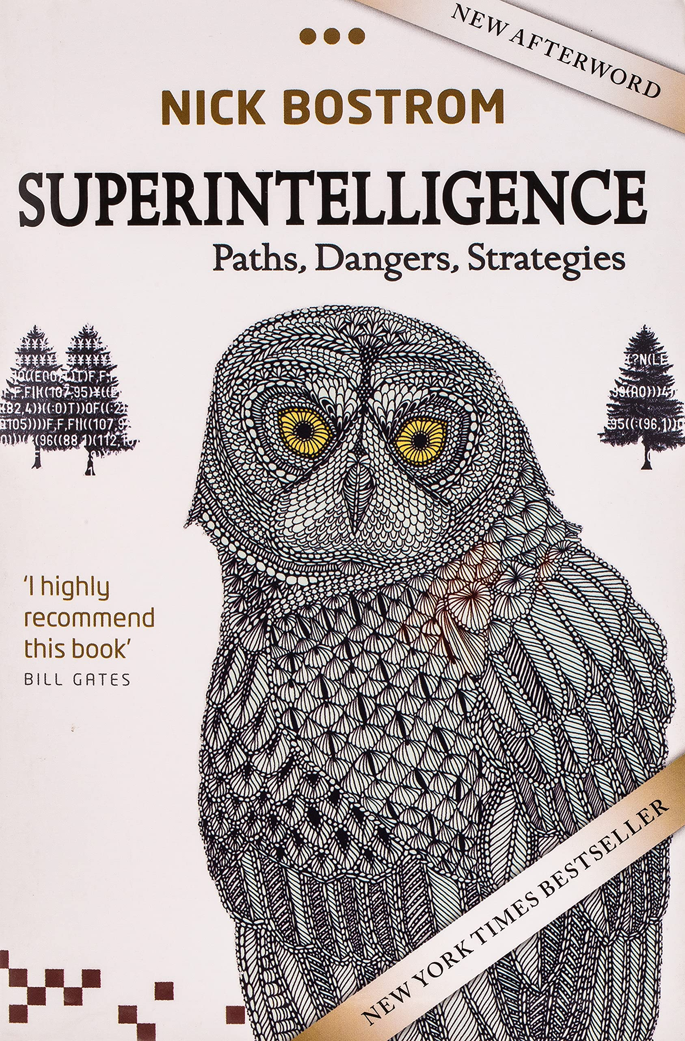
ChatGPT – The good future. What might be coming next?
Personalisation: ChatGPT can be trained on individual users' preferences and past interactions, allowing for more personalised and tailored conversations.
Integration with most software products: Generating written content that is indistinguishable from human-written content.
Improved Customer Service: Large language models could revolutionise customer service by providing more personalised and efficient support to customers.
Superintelligence?: An artificial intelligence system that surpasses human intelligence in virtually all cognitive abilities, such as problem-solving, decision-making, creativity, and learning.
"Superintelligence could either be the best or the worst thing that could happen to humanity, depending on how it is developed and controlled."

Slide 30
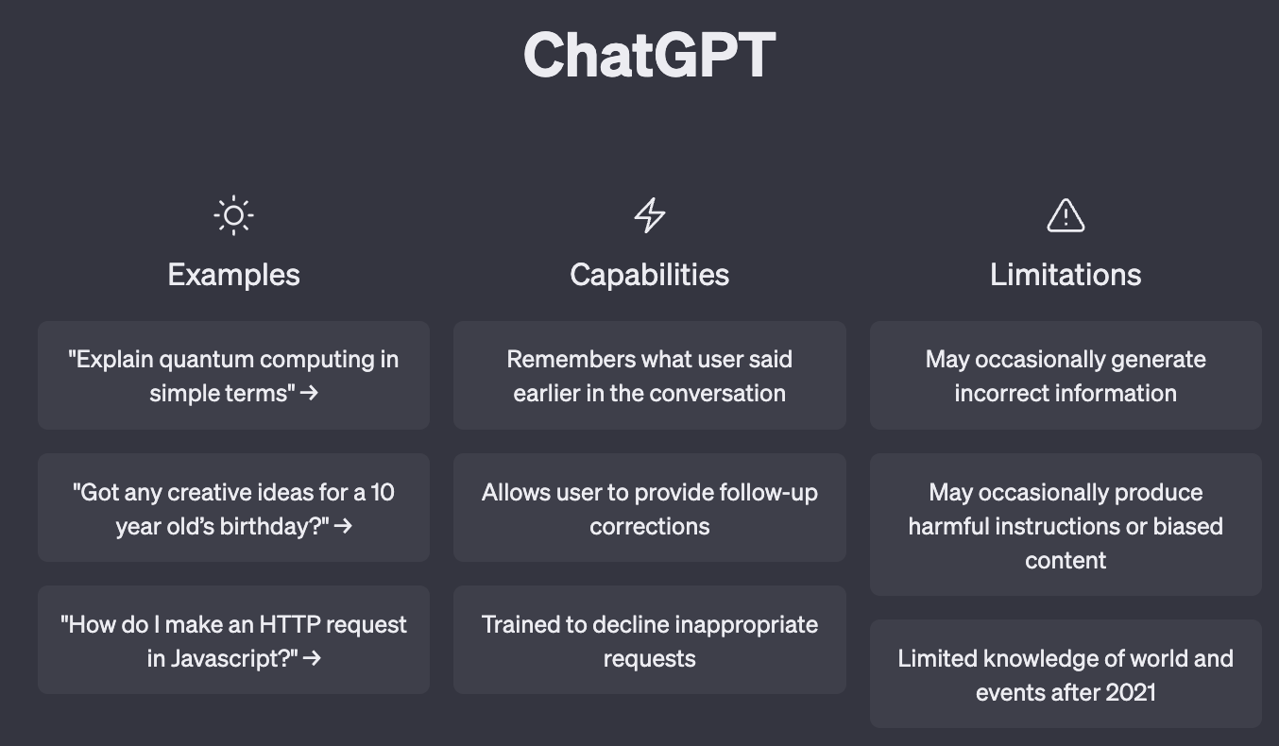
ChatGPT – Limitations, ChatGPT is not a reasoning agent
May occasionally generate incorrect information
Basic Maths
Logic
Argue Incorrect facts
Fails at tasks that require specialized knowledge
May occasionally produce harmful instructions or biased content
ChatGPT was trained on the collective writing of humans across the world
The same biases that exist in the real world can also appear in the model.
Limited knowledge of world and events after 2021
Fails at tasks that require creating new ideas

Slide 31

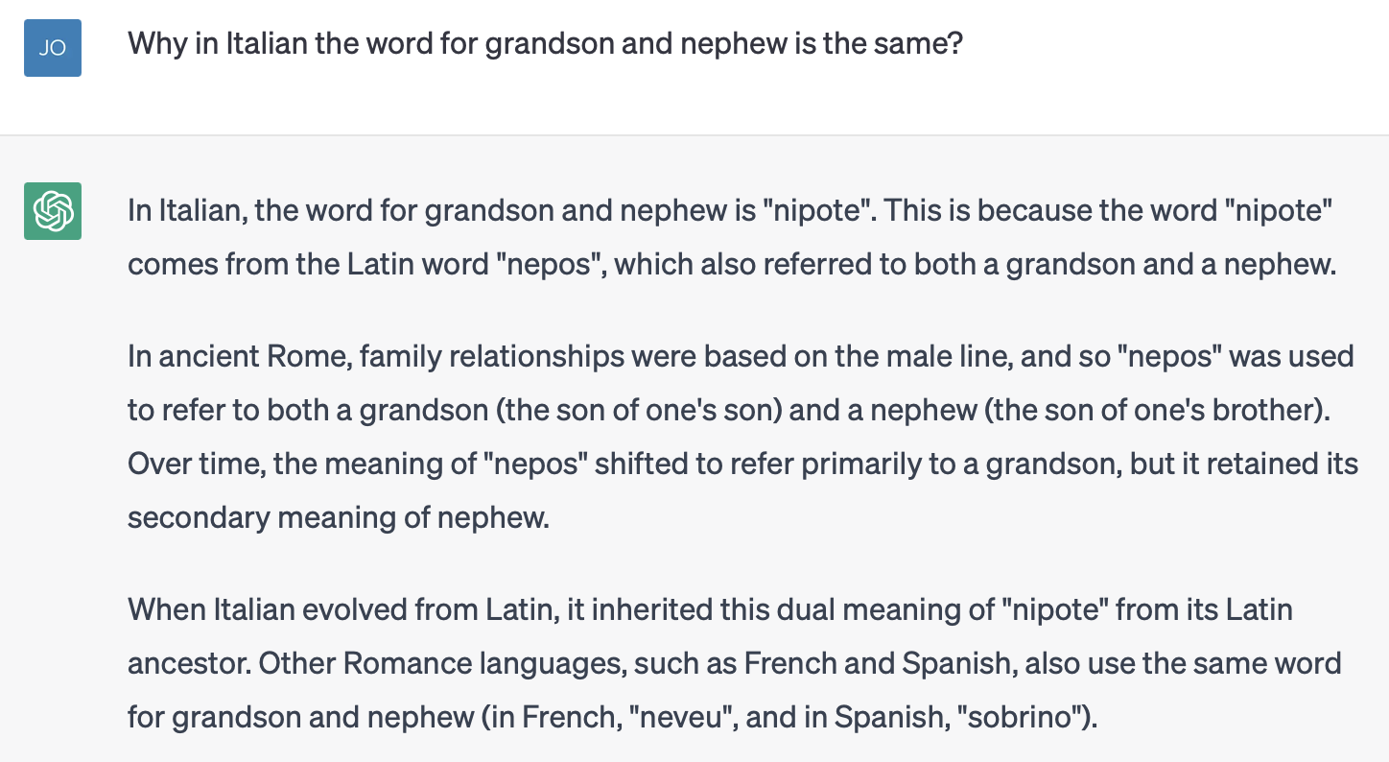
ChatGPT – Examples of issues with reasoning

Slide 32


ChatGPT – Examples of Ethical Issues

Slide 33

Questions?
Questions?

Slide 34
Upcoming ChatGPT Series
Introduction to ChatGPT
How ChatGPT Works
Deep dive into ChatGPT
ChatGPT use cases and how to use
The future of ChatGPT an AI Ethics

